Slide 1
What’s Driving College Costs Higher?
Kevin Stern
Notes:
- main driving factors behind the cost of tuition

Slide 2
Objective
Notes:
Exponential increase over past 30 years
affordability
Concern over debt burden. 2/3 borrow. On average 25k
- Whether I can pin point driving factors

Slide 3
Data Source
“Don't Give Up on a College Because of Its Sticker Price”
“Find money for college!”
“What will college really cost?”
“Find out how much colleges expect you to pay”
“Financing your college education”
Notes:
2000 colleges
20 features

Slide 4
ACT
SAT Math
SAT Reading
Admission Rate
Area Population
Average Age
Average Financial Need Award
Average GPA
Average Indebtness
Campus Size
Is Freshman Housing Guaranteed?
Percent of Students who Got Financial Need
Institution Type (Private vs. Public)
Number of Grad Students
Number of Undergrad Students
Percent of International Students
Graduation Rate
Percent of Students with Loans
Percent of Undergrad Women
Average Class Size
Full List of Features
Notes:
6 categories
Admission rate & avg financial need awarded
Exclusivity
Plots
Next slide, bottom left graph for admission rate

Slide 5
Notes:
-admission rate
-financial need awarded – higher cost, more need to borrow
-mean imputing?

Slide 6
ACT
SAT Math
SAT Reading
Admission Rate
Area Population
Average Age
Average Financial Need Award
Average GPA
Average Indebtness
Campus Size
Is Freshman Housing Guaranteed?
Percent of Students who Got Financial Need
Institution Type (Private vs. Public)
Number of Grad Students
Number of Undergrad Students
Percent of International Students
Graduation Rate
Percent of Students with Loans
Percent of Undergrad Women
Average Class Size
Full List of Features
R² = 0.620
CV = 0.518

Slide 7
ACT
SAT Reading
Admission Rate
Average Age
Average Financial Need Award
Average Indebtness
Number of Undergrad Students
Percent of International Students
Graduation Rate
Percent of Undergrad Women
Average Class Size
Final List of Features
R² = 0.619
CV = 0.528

Slide 8
CV R² = 0.528

Slide 9
Key Features
Admission Rate
% International Students
% Undergrad Women
% Graduating
Notes:
-Admission Rate
-International students more likely to pay – maybe not an issue for colleges that have a large amount of financial need
-Women – Scripps, Barnard, Juilliard
- Percent graduating / ACT = good students

Slide 10
Notes:
-which types of schools were well predicted? What wasn’t?
-color coded, couldn’t find anything, except for…

Slide 11
Notes:
- Color coded residuals by admission rate.
- Outliers are NON exclusive schools

Slide 12
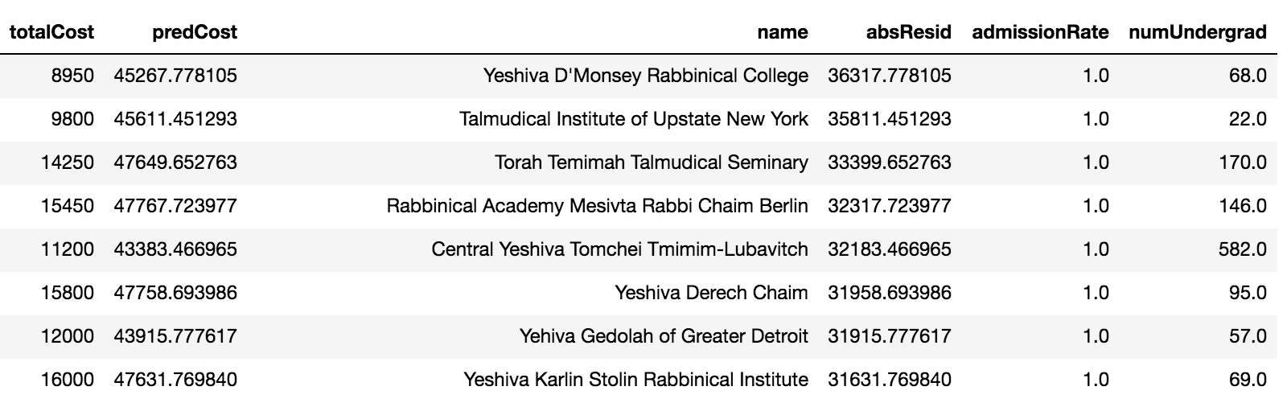
Notes:
-Religious schools with low number of students
As you can see, a large proportion of these are religious schools, which probably don’t adhere to the traditional structure of a university, as they have an extremely small amount of students.

Slide 13
Takeaways
What else could be contributing to the cost of tuition?
Next steps
Notes:
Political landscape - loan limits & limited funding
Recursive effect – compare to costs of similar colleges
Data over time
Better way of filling NaNs

Slide 14
Questions?

Slide 15
Technical Appendix

Slide 16
Distribution of Tuition Cost
Notes:
The first step was to check the distribution of tuition cost, which I found to be fairly normally distributed, so I decided not to transform as to not lose any interpretability.

Slide 18
Alpha Selection for Final Set of Features through Lasso Regularization
List of alphas =[1e-5,1e-4,1e-3,1e-2,1e-1,0,1,100]

Slide 19
Polynomial Degree Selection

Slide 20
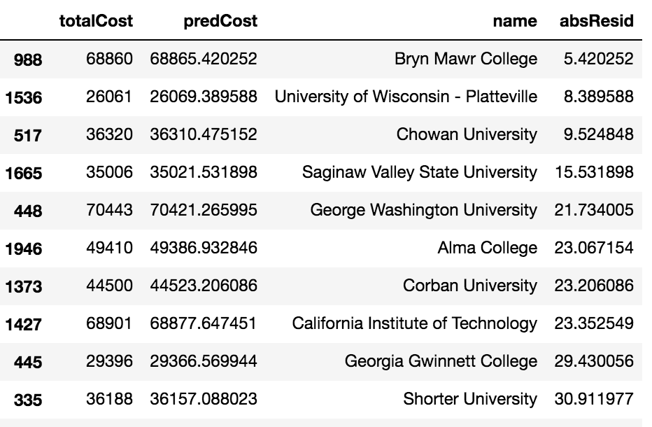

Slide 21
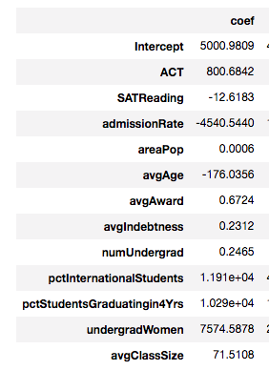
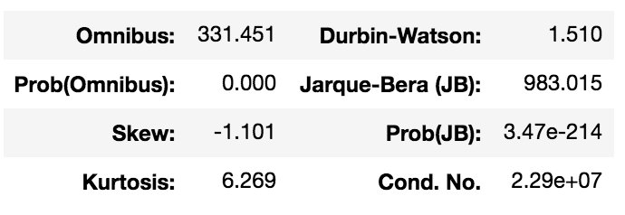
Final Model Coefficients

Slide 22
SAMPLE DATA
{'nearestAirport': u'20 mile(s) from campus in Lexington', 'freshmanHousingGuaranteed': u'Freshmen are guaranteed housing', 'pctWithLoans': u'70%', 'numGrad': u'2,517', 'SATMath': u'483 average ', 'ACT': u'22 average ', 'classSize': u'2-9 students: 20% of classes', 'pctInternationalStudents': u'1.6% from 44 countries', 'nearestTrain': u'\xa0', 'id': u'944', 'totalCost': [u'In-state: 22,014′,u′Out−of−state:22,014′,u′Out−of−state:31,792'], 'tuitionCost': [u'In-state: 9,296′,u′Out−of−state:9,296′,u′Out−of−state:19,074'], 'roomCost': [u'9,018′],′schoolColors′:u′Maroonandwhite′,′sportsDivision′:u′NCAADivisionI′,′sororities′:u′69,018′],′schoolColors′:u′Maroonandwhite′,′sportsDivision′:u′NCAADivisionI′,′sororities′:u′62,700'], 'numFaculty': u'Not reported', 'areaPop': u'32,550', 'campusSize': u'500 acres', 'download_slot': 'www.collegedata.com', 'coed': u'Yes', 'pctAdvancedStudy': u'Not reported', 'undergradMen': u'8,181 (57.1%)', 'download_timeout': 180.0, 'avgAge': u'23', 'SATReading': u'481 average ', 'gotFinancialNeed': u'7,775 (97.6%) of applicants with financial need', 'fraternities': u' 8% of men participate', 'avgIndebtness': u' 34,358′,′mascot′:u′Colonel′,′bookCost′:[u′34,358′,′mascot′:u′Colonel′,′bookCost′:[u′1,000'], 'avgAward': u'$10,962', 'admissionRate': u'71% of 10,215 applicants were admitted', 'name': u'Eastern Kentucky University', 'SATWriting': u'457 average ', 'url': u'https://www.collegedata.com/cs/data/college/college_pg01_tmpl.jhtml?schoolId=944', 'institutionType': u'Public', 'pctEmployedin6Mo': u'Not reported', 'depth': 6, 'download_latency': 2.5333781242370605, 'undergradWomen': u'8,181 (57.1%)'}

